Slide 1
Chapter 3
Memory Management

Slide 2
Memory Management Basics
Don’t have infinite RAM
Do have a memory hierarchy-
  Cache (fast)
  Main(medium)
  Disk(slow)
Memory manager has the job of using this hierarchy to create an abstraction (illusion) of easily accessible memory

Slide 3

One program at a time in memory
OS reads program in from disk and it is executed

Slide 4
One program at a time
Can only have one program in memory at a time.
Bug in user program can trash the OS (a and c)
Second on some embedded systems
Third on MS-DOS (early PCs) -part in ROM called BIOS

Slide 5
Really want to run more than one program
Could swap new program into memory from disk and send old one out to disk
Not really concurrent

Slide 6
How to run more programs then fit in main memory at once
Can’t keep all processes in main memory
  Too many (hundreds)
  Too big (e.g. 200 MB program)
Two approaches
  Swap-bring program in and run it for a while
  Virtual memory-allow program to run even if only part of it is in main memory

Slide 7

Swapping, a picture
Initially, only process A is in memory. Then processes B and C are created or swapped in from disk. In Fig. 3-4(d) A is swapped out to disk. Then D comes in and B goes out. Finally A comes in again. Since A is now at a different location, addresses contained in it must be relocated, either by software when it is swapped in or (more likely) by hardware during program execution.
When swapping creates multiple holes in memory, it is possible to combine them all into one big one by moving all the processes downward as far as possible. This technique is known as memory compaction

Slide 8
Swapping
Two general approaches to dealing with memory overload have been developed over the years. The simplest strategy, called swapping, consists of bringing in each process in its entirety, running it for a while, then putting it back on the disk.
The other strategy, called virtual memory, allows programs to run even when they are only partially in main memory

Slide 9
Programs grow as they execute
Stack (return addresses and local variables)
Data segment (heap for variables which are dynamically allocated and released)
Good idea to allocate extra memory for both
If, however, processes’ data segments can grow, for example, by dynamically allocating memory from a heap, as in many programming languages, a problem occurs whenever a process tries to grow.
If a hole is adjacent to the process, it can be allocated and the process allowed to grow into the hole.
On the other hand, if the process is adjacent to another process, the growing process will either have to be moved to a hole in memory large enough for it, or one or more processes will have to be swapped out to create a large enough hole.

Slide 10

2 ways to allocate space for growth
Just add extra space
Stack grows downwards, data grows upwards

Slide 11
If processes can have two growing segments—for example, the data segment being used as a heap for variables that are dynamically allocated and released and a stack segment for the normal local variables and return addresses—an alternative arrangement suggests itself, namely that of Fig. 3-5(b).
In this figure we see that each process illustrated has a stack at the top of its allocated memory that is growing downward, and a data segment just beyond the program text that is growing upward. The memory between them can be used for either segment.
If it runs out, the process will either have to be moved to a hole with sufficient space, swapped out of memory until a large enough hole can be created, or killed

Slide 12
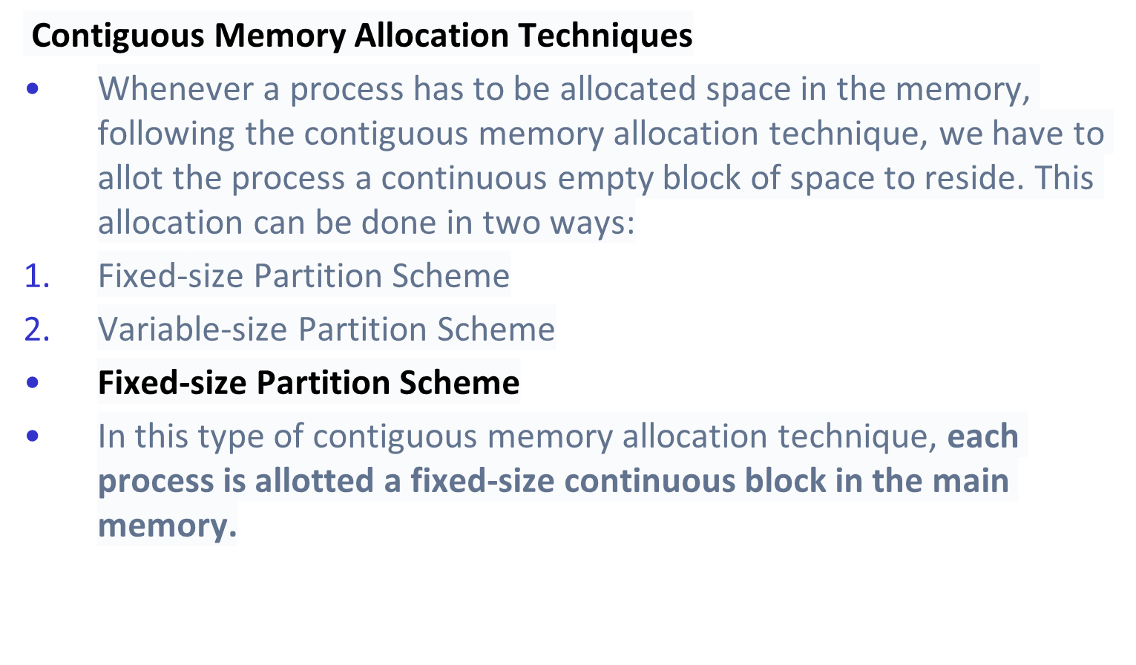
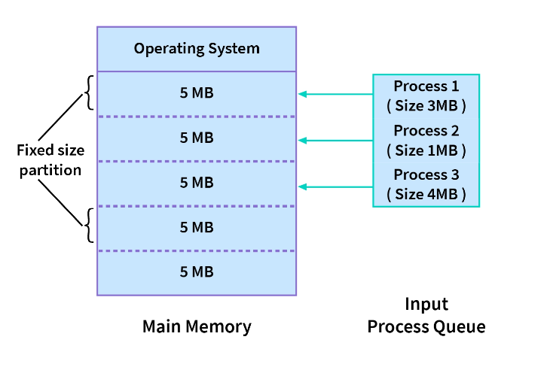

Slide 13
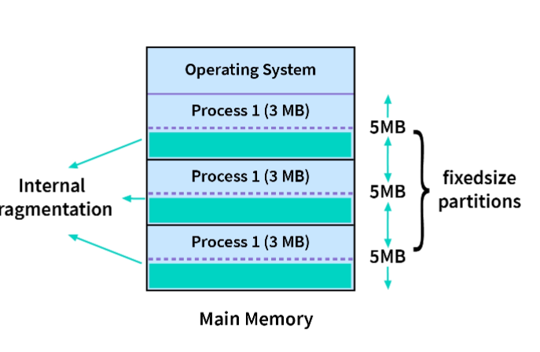
Advantages
The advantages of a fixed-size partition scheme are:
Because all of the blocks are the same size, this scheme is simple to implement. All we have to do now is divide the memory into fixed blocks and assign processes to them.
It is easy to keep track of how many blocks of memory are left, which in turn decides how many more processes can be given space in the memory.
As at a time multiple processes can be kept in the memory, this scheme can be implemented in a system that needs multiprogramming.
Disadvantages
Though the fixed-size partition scheme has many advantages, it also has some disadvantages:
As the size of the blocks is fixed, we will not be able to allot space to a process that has a greater size than the block.
The size of the blocks decides the degree of multiprogramming, and only that many processes can remain in the memory at once as the number of blocks.
Internal fragmentation and external Fragmentation. Hence, this technique may lead to space wastage

Slide 14
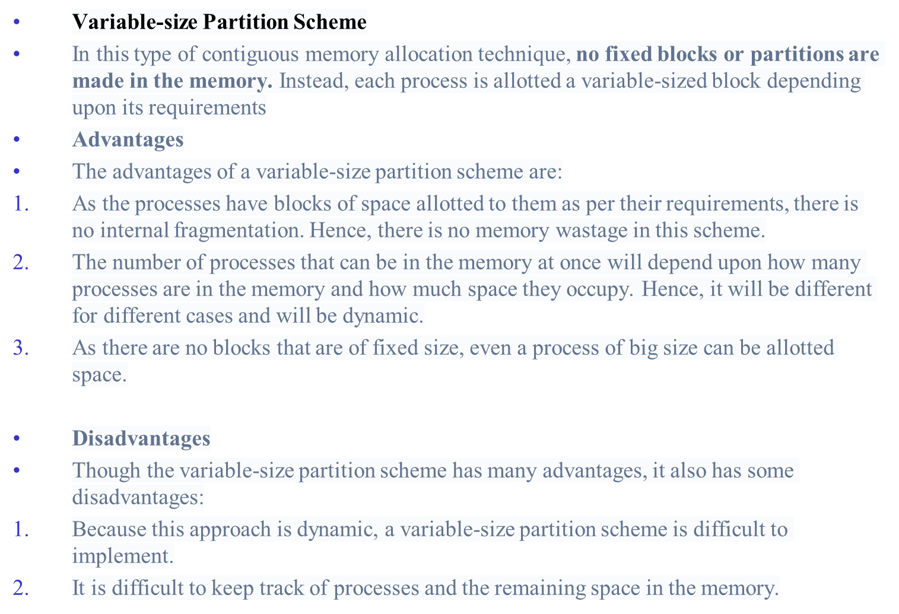

Slide 15
Managing Free Memory
Two techniques to keep track of free memory
  Bitmaps -corresponding to each allocation unit is a bit in the bitmap, which is 0 if the unit is free and 1 if it is occupied (or vice versa).
  Linked lists - other way of keeping track of memory is to maintain a linked list of allocated and free memory segments, where a segment either contains a process or is an empty hole between two processes.

Slide 16

Bitmaps-the picture
(a)Picture of memory
(b)Each bit in bitmap corresponds to a unit of storage (e.g. bytes) in memory
(c) Linked list P: process H: hole

Slide 17
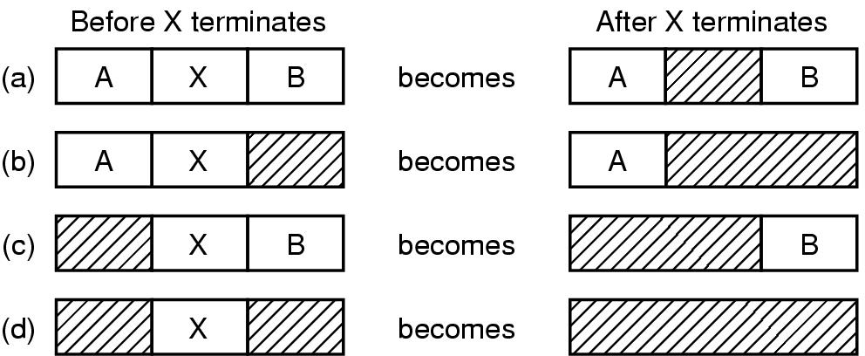
Linked Lists-the picture
Four neighbor combinations for the terminating process, X.

Slide 18
Linked Lists
Algorithms to fill in the empty spaces in memory
  First fit
  Next fit
  Best fit
  Worst fit
  Quick fit

Slide 19
The fits
First fit-fast
Next fit-starts search wherever it is
  Slightly worse
Best fit-smallest hole that fits
  Slower, results in a bunch of small holes (i.e. worse algorithm)
Worst fit-largest hole that fits
  Not good (simulation results)
Quick fit- keep list of common sizes
  Quick, but can’t find neighbors to merge with

Slide 20
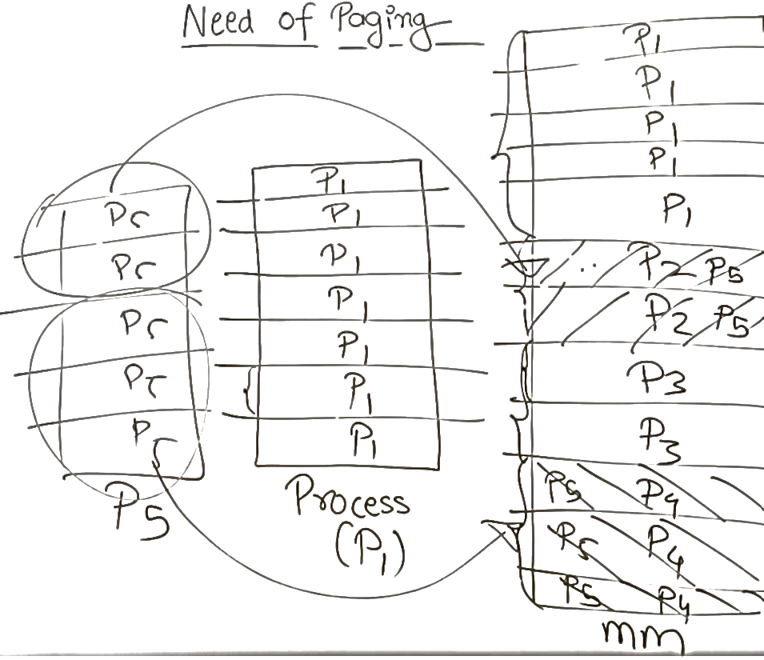
Paging
Internal fragmentation is removed by variable length memory allocation
External fragmentation is removed by paging

Slide 21
An address that is created by the CPU while a program is running is known as a logical address. Because the logical address is virtual—that is, it doesn't exist physically.
Physical Address-The physical address represents the actual physical location of data in memory or devices.
Page offset(d): It refers to the number of bits necessary to represent a certain word on a page, page size in Logical Address Space,

Slide 22
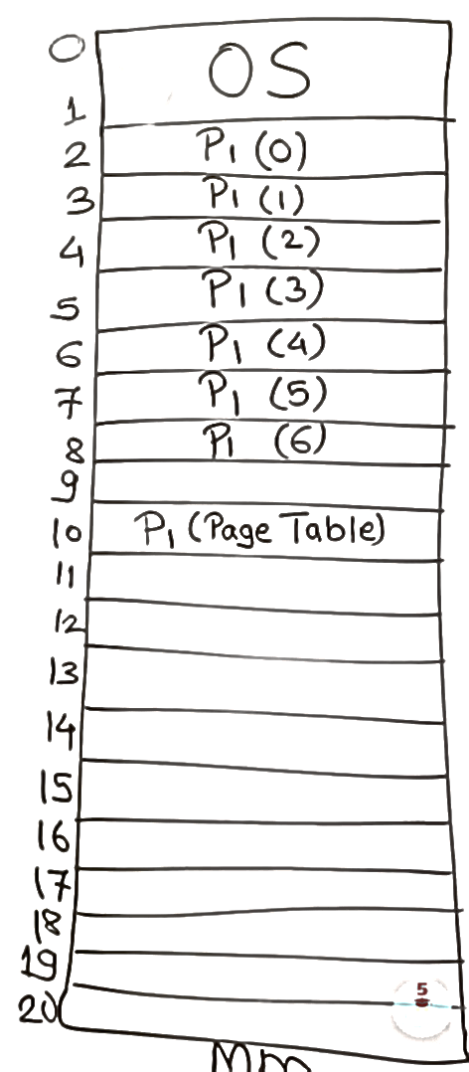
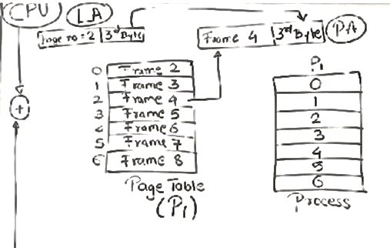
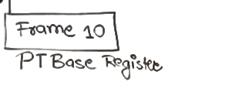
Page Table

Slide 23
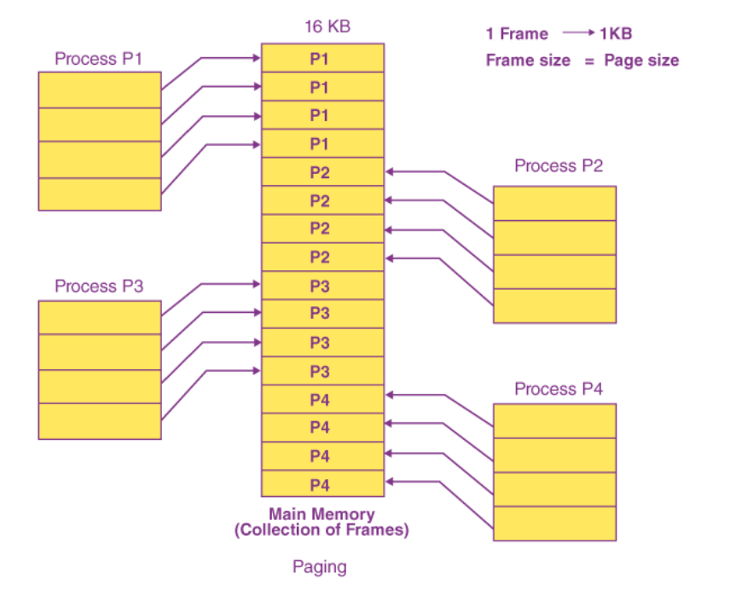
Multiple Page Table

Slide 24
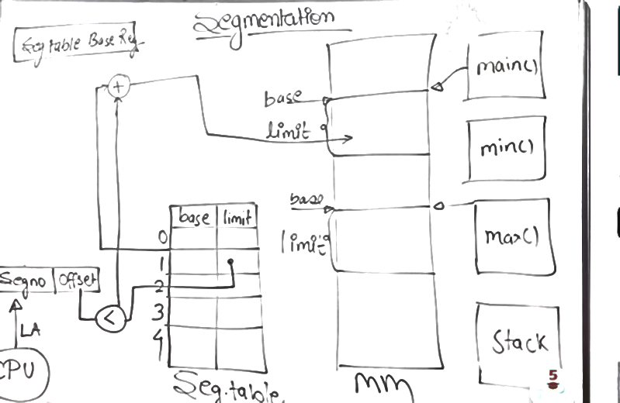

Slide 25
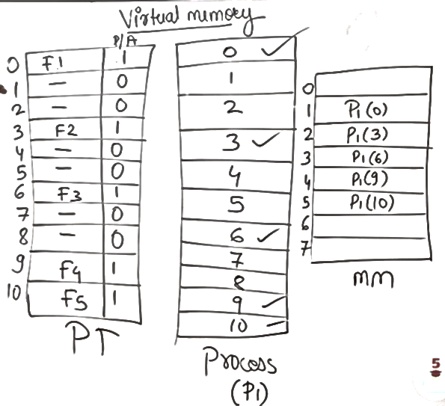

Slide 26
Virtual Memory-the history
Keep multiple parts of programs in memory
Swapping is too slow (100 Mbytes/sec disk transfer rate=>10 sec to swap out a 1 Gbyte program)
Overlays-programmer breaks program into pieces which are swapped in by overlay manager
  Ancient idea-not really done
  Too hard to do-programmer has to break up program

Slide 27
Virtual Memory
The basic idea behind virtual memory is that each program has its own address space, which is broken up into chunks called pages.
Each page is a contiguous range of addresses. These pages are mapped onto physical memory, but not all pages have to be in physical memory at the same time to run the program.
When the program references a part of its address space that is in physical memory, the hardware performs the necessary mapping on the fly.
When the program references a part of its address space that is not in physical memory, the operating system is alerted to go get the missing piece and re-execute the instruction that failed

Slide 28
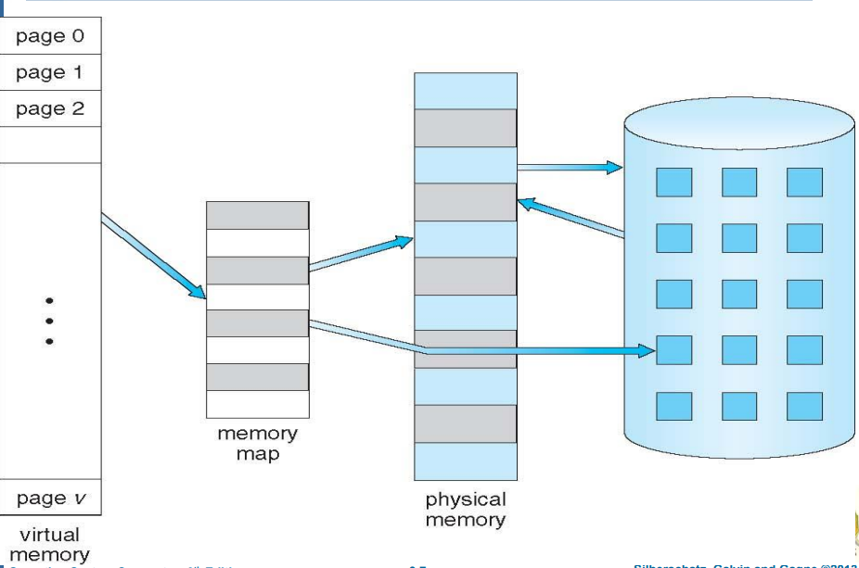


Slide 29
Virtual Memory
Program’s address space is broken up into fixed size pages
Pages are mapped to physical memory
If instruction refers to a page in memory, fine
Otherwise OS gets the page, reads it in, and re-starts the instruction
While page is being read in, another process gets the CPU

Slide 30
Memory Management Unit
Memory Management Unit generates physical address from virtual address provided by the program. These generated addresses are called virtual addresses and form the virtual address space.
On computers without virtual memory, the virtual address is put directly onto the memory bus and causes the physical memory word with the same address to be read or written.
When virtual memory is used, the virtual addresses do not go directly to the memory bus.
Instead, they go to an MMU (Memory Management Unit) that maps the virtual addresses onto the physical memory addresses
In this example, we have a computer that generates 16-bit addresses, from 0 up to 64K − 1. These are the virtual addresses.
This computer, however, has only 32 KB of physical memory. So although 64-KB programs can be written, they cannot be loaded into memory in their entirety and run.
The virtual address space consists of fixed-size units called pages.
The corresponding units in the physical memory are called page frames. The pages and page frames are generally the same size.

Slide 31

Memory Management Unit
MMU maps virtual addresses to physical addresses and puts them on memory bus

Slide 32
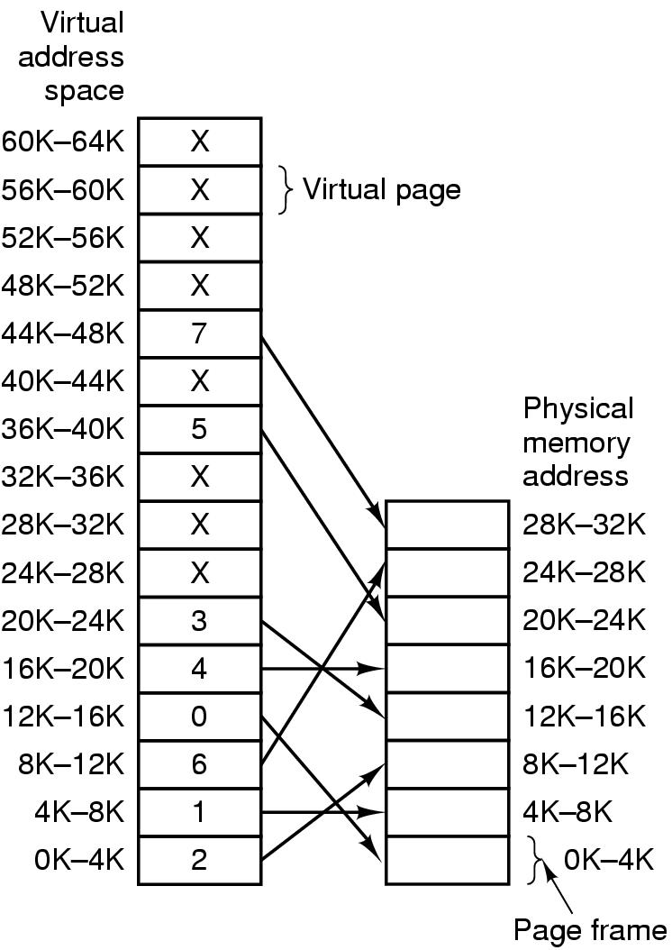
Mapping of pages to page frames
The range marked 0K–4K means that the virtual or physical addresses in that page are 0 to 4095.
The range 4K–8K refers to addresses 4096 to 8191, and so on.
Each page contains exactly 4096 addresses starting at a multiple of 4096 and ending one shy of a multiple of 4096.
When the program tries to access address 0, for example, using the instruction MOV REG,0 virtual address 0 is sent to the MMU.
The MMU sees that this virtual address falls in page 0 (0 to 4095), which according to its mapping is page frame 2 (8192 to 12287).
It thus transforms the address to 8192 and outputs address 8192 onto the bus.
16 bit addresses, 4 KB pages
32 KB physical memory,
16 virtual pages and 8 page frames

Slide 33
The range marked 0K–4K means that the virtual or physical addresses in that page are 0 to 4095.
The range 4K–8K refers to addresses 4096 to 8191, and so on. Each page contains exactly 4096 addresses starting at a multiple of 4096 and ending one shy of a multiple of 4096.
When the program tries to access address 0, for example, using the instruction MOV REG,0 virtual address 0 is sent to the MMU. The MMU sees that this virtual address falls in page 0 (0 to 4095), which according to its mapping is page frame 2 (8192 to 12287). It thus transforms the address to 8192 and outputs address 8192 onto the bus.
The memory knows nothing at all about the MMU and just sees a request for reading or writing address 8192, which it honors. Thus, the MMU has effectively mapped all virtual addresses between 0 and 4095 onto physical addresses 8192 to 12287.
Similarly, the instruction MOV REG,8192 is effectively transformed into MOV REG,24576 because virtual address 8192 (in virtual page 2) is mapped onto 24576 (in physical page frame 6)

Slide 34
Page Fault Processing
Present/absent bit tells whether page is in memory
What happens If address is not in memory?
Trap to the OS
  OS picks page to write to disk
  Brings page with (needed) address into memory
  Re-starts instruction

Slide 35
Page Table
Virtual address={virtual page number, offset}
Virtual page number used to index into page table to find page frame number
If present/absent bit is set to 1, attach page frame number to the front of the offset, creating the physical address which is sent on the memory bus

Slide 36

MMU operation
An example of a virtual address, 8196 (0010000000000100 in binary), being mapped using the MMU map.
The incoming 16-bit virtual address is split into a 4-bit page number and a 12-bit offset.
With 4 bits for the page number, we can have 16 pages, and with 12 bits for the offset, we can address all 4096 bytes within a page.
The page number is used as an index into the page table, yielding the number of the page frame corresponding to that virtual page.
If the Present/absent bit is 0, a trap to the operating system is caused.
If the bit is 1, the page frame number found in the page table is copied to the high-order 3 bits of the output register, along with the 12-bit offset, which is copied unmodified from the incoming virtual address.
Together they form a 15-bit physical address. The output register is then put onto the memory bus as the physical memory address.

Slide 37

Structure of Page Table Entry
Modified (dirty) bit: 1 means written to => have to write it to disk. 0 means don’t have to write to disk.
Referenced bit: 1 means it was either read or written. Used to pick page to evict. The Referenced bit is set whenever a page is referenced, either for reading or for writing.
Present (1) / Absent (0) bit. If this bit is 1, the entry is valid and can be used. If it is 0, the virtual page to which the entry belongs is not currently in memory. Accessing a page table entry with this bit set to 0 causes a page fault.
Protection bits: r, w, r/w
.

Slide 38
Speed up Address Translation
Most programs access a small number of pages a great deal
Add Translation Lookaside Buffer (TLB) to MMU
  Stores frequently accessed frames
  small hardware device for mapping virtual addresses to physical addresses without going through the page table. The device, called a TLB (Translation Lookaside Buffer) or sometimes an associative memory.
  It is usually inside the MMU and consists of a small number of entries.
  Each entry contains information about one page, including the virtual page number, a bit that is set when the page is modified, the protection code (read/write/execute permissions), and the physical page frame in which the page is located.
  Another bit indicates whether the entry is valid (i.e., in use) or not.

Slide 39
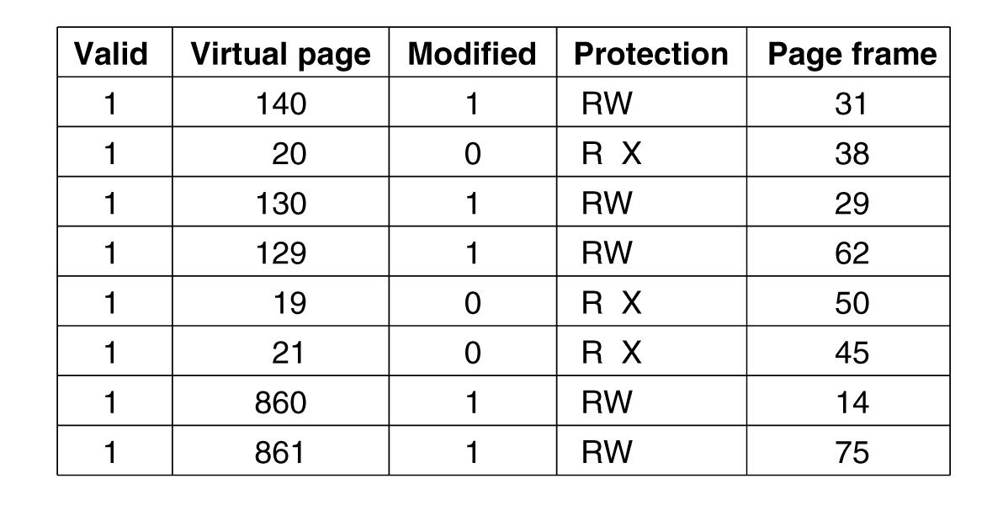
Translation Lookaside Buffers
Valid bit indicates whether page is in use or not

Slide 40
Translation Lookaside Buffer(TLB)
If address is in MMU, avoid page table
Uses parallel search to see if virtual page is in the TLB
If not, does page table look up and evicts TLB entry, replacing it with page just looked up

Slide 41
Translation Lookaside Buffer- Functioning
When a virtual address is presented to the MMU for translation, the hardware first checks to see if its virtual page number is present in the TLB by comparing it to all the entries simultaneously (i.e., in parallel).
If a valid match is found and the access does not violate the protection bits, the page frame is taken directly from the TLB, without going to the page table.
If the virtual page number is present in the TLB but the instruction is trying to write on a read-only page, a protection fault is generated.

Slide 42
Translation Lookaside Buffer- Functioning
The interesting case is what happens when the virtual page number is not in the TLB.
The MMU detects the miss and does an ordinary page table lookup.
It then evicts one of the entries from the TLB and replaces it with the page table entry just looked up.
Thus if that page is used again soon, the second time it will result in a TLB hit rather than a miss.

Slide 43
Software TLB management
Risc machines manage TLB in software
TLB fault processed by OS instead of by MMU hardware
Results less hardware in MMU and OK performance
Software can figure out which pages to pre-load into TLB (eg. Load server after client request)
Keeps cache of frequently used pages

Slide 44
Software TLB management
When a TLB miss occurs, instead of the MMU going to the page tables to find and fetch the needed page reference, it just generates a TLB fault and tosses the problem into the lap of the operating system. The system must find the page, remove an entry from the TLB, enter the new one, and restart the instruction that faulted.
A soft miss occurs when the page referenced is not in the TLB, but is in memory. All that is needed here is for the TLB to be updated. No disk I/O is needed. In contrast, a hard miss occurs when the page itself is not in memory (and of course, also not in the TLB).
Tanenbaum, Modern Operating Systems 3 e, (c) 2008 Prentice-Hall, Inc. All rights reserved. 0-13-6006639

Slide 45
Page Replacement Algorithms
If new page is brought in, need to chose a page to evict
Don’t want to evict heavily used pages
If page has been written to, need to copy it to disk.
Otherwise, a good copy is on the disk=>can write over it

Slide 46
Page Replacement Algorithms
Optimal page replacement algorithm
Not recently used page replacement
First-in, first-out page replacement
Second chance page replacement
Clock page replacement
Least recently used page replacement
Working set page replacement
WSClock page replacement

Slide 47
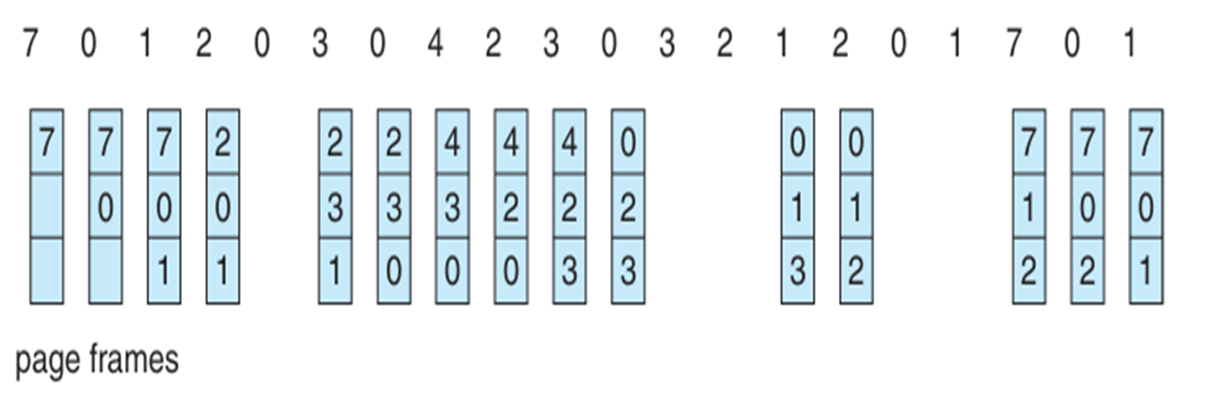
FIFO
Keep list ordered by time (latest to arrive at the end of the list)
Evict the oldest, i.e. head of the line
Easy to implement
Oldest might be most heavily used! No knowledge of use is included in FIFO

Slide 48
Second Chance Algorithm
A simple modification to FIFO that avoids the problem of throwing out a heavily used page is to inspect the R bit of the oldest page.
If it is 0, the page is both old and unused, so it is replaced immediately.
If the R bit is 1, the bit is cleared, the page is put onto the end of the list of pages, and its load time is updated as though it had just arrived in memory. Then the search continues.
second chance is looking for is an old page that has not been referenced in the most recent clock interval. If all the pages have been referenced, second chance degenerates into pure FIFO.

Slide 49
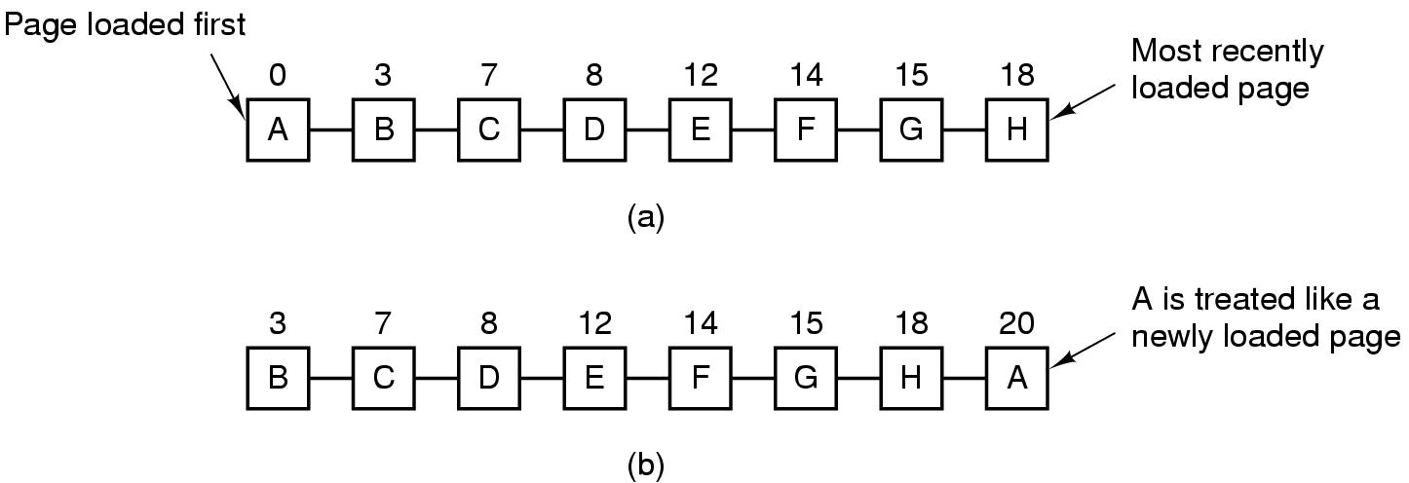
Second Chance Algorithm
Pages sorted in FIFO order by arrival time.
Examine R bit. If zero, evict. If one, put page at end of list and R is set to zero.
If change value of R bit frequently, might still evict a heavily used page

Slide 50
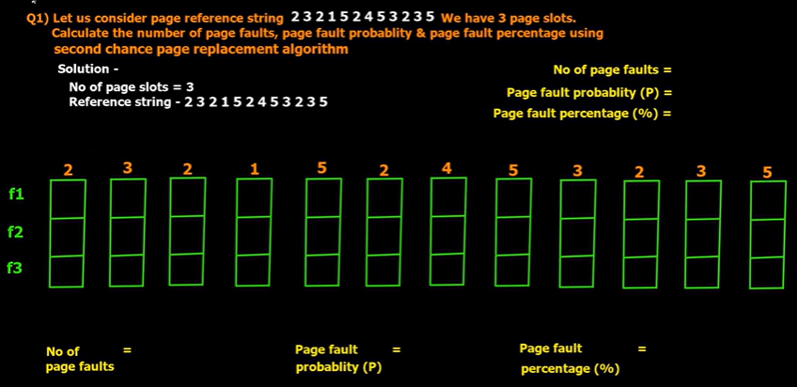
Page Replacement Algorithms
Second chance page replacement:

Slide 51
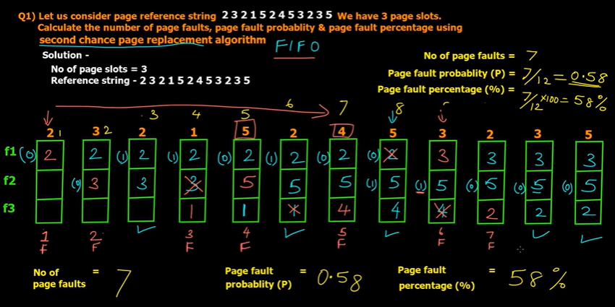
Page Replacement Algorithms
Second chance page replacement:

Slide 52
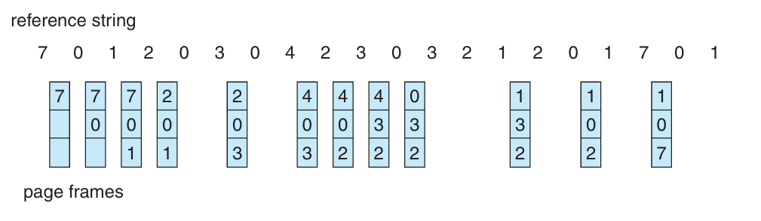
We can replace the page that has not been used for the longest period of time. This approach is the least recently used(LRU) algorithm.

Slide 53
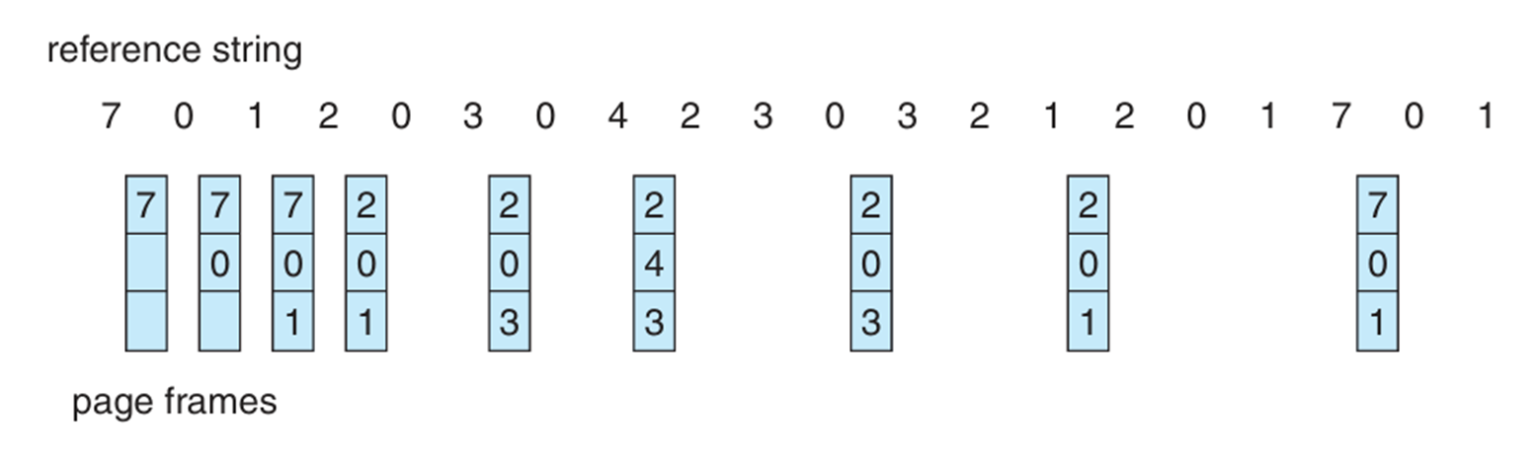
Optimal Page Replacement
Pick the one which will not used before the longest time
Not possible unless know when pages will be referenced (crystal ball)
Used as ideal reference algorithm

Slide 54
Not recently used
Use R and M bits R is set whenever the page is referenced (read or written). M is set when the page is written to (i.e., modified).
When a process is started up, all of its page table entries are marked as not in memory. As soon as any page is referenced, a page fault will occur.
The operating system then sets the R bit (in its internal tables), changes the page table entry to point to the correct page, with mode READ ONLY, and restarts the instruction.
If the page is subsequently modified, another page fault will occur, allowing the operating system to set the M bit and change the page’s mode to READ/WRITE.

Slide 55
Page Replacement Algorithms
Not recently used page replacement:
removes a page at random from the lowest numbered non-empty class.
Not Recently Used (NRU) is a page replacement algorithm used in operating systems to determine which page to replace in memory when a page fault occurs.
The NRU algorithm divides pages into four categories based on their usage history, and selects a page for replacement from the category with the lowest priority.
Category 0: Pages that have not been referenced and modified recently
Category 1: Pages that have not been referenced recently but have been modified recently
Category 2: Pages that have been referenced recently but have not been modified recently
Category 3: Pages that have been referenced and modified recently

Slide 56
Page Replacement Algorithms
Not recently used page replacement:
Steps in NRU Algorithm
The following steps form the basis of how the NRU (Not Recently Used) page replacement mechanism works −
A reference bit (R) and a modified bit (M) are given to every page in memory. Normally, each page table entry for a page contains these parts.
The algorithm starts the NRU selection procedure at regular intervals or in response to specified events (such as clock ticks or timer interrupts).
Based on their R and M bits, the algorithm sorts all of the pages in memory into one of the following four classes−
Class 0 − Pages have R and M values of 0.
Class 1 − Pages have R = 0 and M = 1.
Class 2 − ages where R = 1 and M = 0.
Class 3 − Pages where R and M both equal 1.

Slide 57
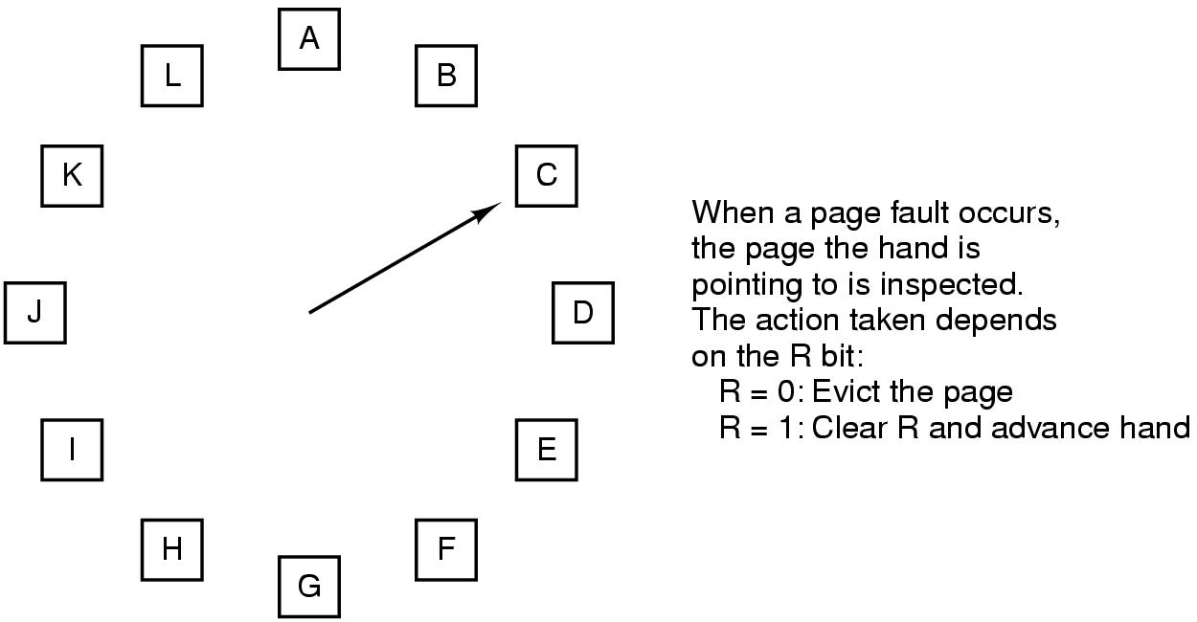
The Clock Page Replacement Algorithm

Slide 58
Clock
Doesn’t use age as a reason to evict page
Faster-doesn’t manipulate a list
Doesn’t distinguish between how long pages have not been referenced

Slide 59
Working Set Model
Demand paging-bring a process into memory by trying to execute first instruction and getting page fault. Continue until all pages that process needs to run are in memory (the working set)
The set of pages that a process is currently using is its working set.
If the entire working set is in memory, the process will run without causing many faults until it moves into another execution phase.
If the available memory is too small to hold the entire working set, the process will cause many page faults and run slowly
Try to make sure that working set is in memory before letting process run (pre-paging)
Thrashing-memory is too small to contain working set, so page fault all of the time

Slide 60
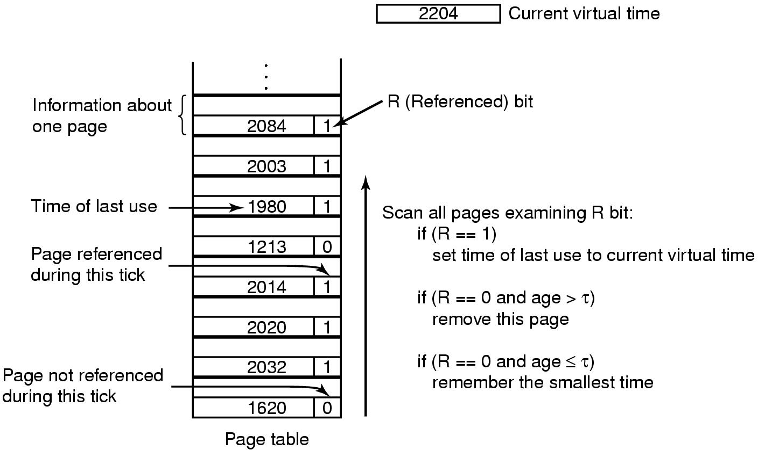
Working Set Page Replacement
(Check each clock tick)
If it is 1, the current virtual time is written into the Time of last use field in the page table, indicating that the page was in use at the time the fault occurred.
Since the page has been referenced during the current clock tick, it is clearly in the working set and is not a candidate for removal (τ is assumed to span multiple clock ticks).
If R is 0, the page has not been referenced during the current clock tick and may be a candidate for removal. To see whether or not it should be removed, its age (the current virtual time minus its Time of last use) is computed and compared to τ .
If the age is greater than τ , the page is no longer in the working set and the new page replaces it. The scan continues updating the remaining entries.
However, if R is 0 but the age is less than or equal to τ , the page is still in the working set. The page is temporarily spared, but the page with the greatest age (smallest value of Time of last use) is noted.

Slide 61
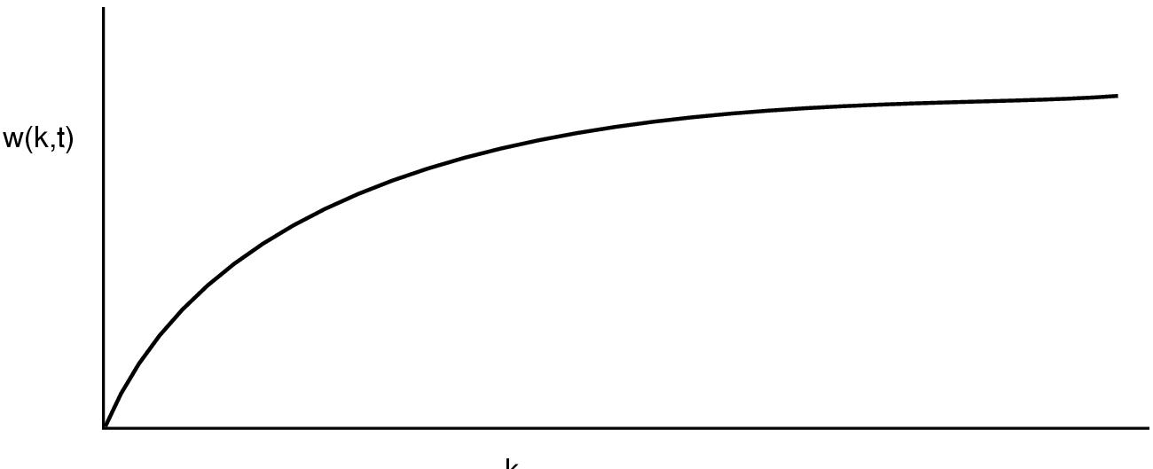
Behavior of working set as a function of k
W(k,t) is number of pages at time t used by k most recent memory references

Slide 62
How to implement working set model
When fault occurs can evict page not in working set (if there is such a page)
Need to pick k
Could keep track of pages in memory at every memory reference. Each k references results in a working set.
Shift register implementation. Insert page number at each reference.
Expensive

Slide 63
Use virtual time instead of number of references (k)
Keep track of k last pages referenced during a period t of execution (CPU) time
Virtual time for a process is the amount of CPU time used since it started
  Measure of how much work a process has done

Slide 64
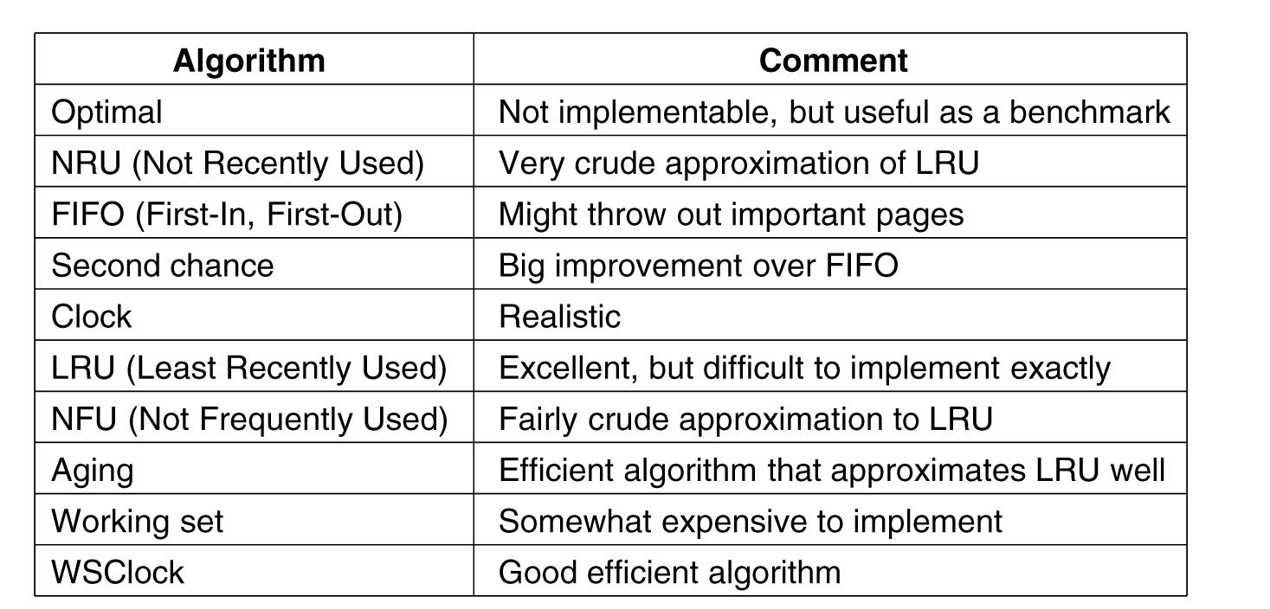
Summary of Page Replacement Algorithms
.

Slide 65
Page Fault Handling
The hardware traps to the kernel, saving the program counter on the stack.
An assembly-code routine is started to save the general registers and other volatile information, to keep the operating system from destroying it.
The operating system discovers that a page fault has occurred, and tries to discover which virtual page is needed.
Once the virtual address that caused the fault is known, the system checks to see if this address is valid and the protection is consistent with the access.
If the page frame selected is dirty, the page is scheduled for transfer to the disk, and a context switch takes place, suspending the faulting process and letting another one run until the disk transfer has completed.
As soon as the page frame is clean (either immediately or after it is written to disk), the operating system looks up the disk address where the needed page is, and schedules a disk operation to bring it in.
When the disk interrupt indicates that the page has arrived, the page tables are updated to reflect its position, and the frame is marked as being in the normal state.
The faulting instruction is backed up to the state it had when it began and the program counter is reset to point to that instruction.
The faulting process is scheduled, and the operating system returns to the (assembly-language) routine that called it.
This routine reloads the registers and other state information and returns to user space to continue execution, as if no fault had occurred

